Slide 1

DEPARTMENT OF INFORMATION SCIENCE & ENGINEERING
“Gaming Using Python Shell”
Presentation By --
NAME : Aditya Sunit Kanoi
USN : 1NH19IS009
Under the Guidance of --
Guide Name: Mrs.B.MOUNICA
Designation: SENIOR ASSISTANCE PROFESSOR

Slide 2


Topic Briefed
Introduction.
Abstract.
Project Objectives.
Existing System.
Proposed System.
H/W, S/W Tools Used with Version No. and other Specifications.
System Design.
Methodology / Work Diagram.
Project Plan : Using Gantt Chart.
Expected Outcome.
Conclusion.

Slide 3


1 :) Introduction – The Start
My project is a non-graphical gaming software compatible with Python 3.0 it a mini-games which are widely popular among people. They are :
1)Who will be the Millionaire.

Slide 4

2 :) Abstract
This program is basically focuses on gaming using python development IDLE. This program will have a user choice to select games he/she want to play.
The program will contain one mini-game based on python platform.
The game is a multi-level quiz based game which will have a multiple rounds of questions and answering right will land you to next question (based on popular TV show “Who will be the Millionaire”); The user will also have an option to see the detailed solution of the questions and simultaneously his/her score.
The games will have a score counter which will help user to view his/her score at end.

Slide 5
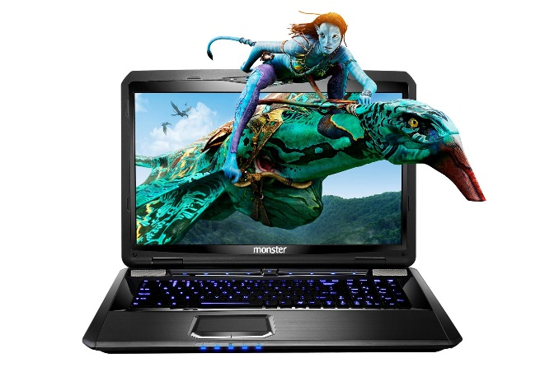
3 :)Project Objectives
To develop a Single-Player interface as Physical and Multiplayer gaming is losing ground.
Simplified gaming tool that is easy to use and handle and works on Offline Platforms.
To enable students to develop software and tool for game development individually and in teams.

Slide 6
4 :)Existing System
Existing System consists of such similar games and systems but has a lack of features like :
Offline Gaming
Time Delay and Friendly Talks with AI look alkies.
Score manager and helps/hints.
New Levels and Dynamic Helps.

Slide 7

5 :) Proposed system
To develop a Single-Player Game over simple software like Python.
To give user a real gaming ground feel by using continuous talks with the PC.
To eradicate Problems like frequent Questioning.
To target more time spending by the user by helping him with Hints and Helps.

Slide 8
6 :) Specifications
Software Used : Pythons IDLE 3.0 for Backend programming
Software Required :Python Shell 3.0 for display and usage for the user.
Operating System : Widows 7 or any upgraded version.
Hardware Requirements : RAM-512 MB (Min)

Slide 9
7 :) Work Diagram
User Input for Name and Introduction to game.
Question Display And Answer Input for the Question. Even Display of Helps/Hints.
Checking the Answer if wrong Quitting the game else incrementing score and proceeding to next question.
Keeping the Score track and help track and displaying when called .
Displaying the winning amount and quitting the game.

Slide 10
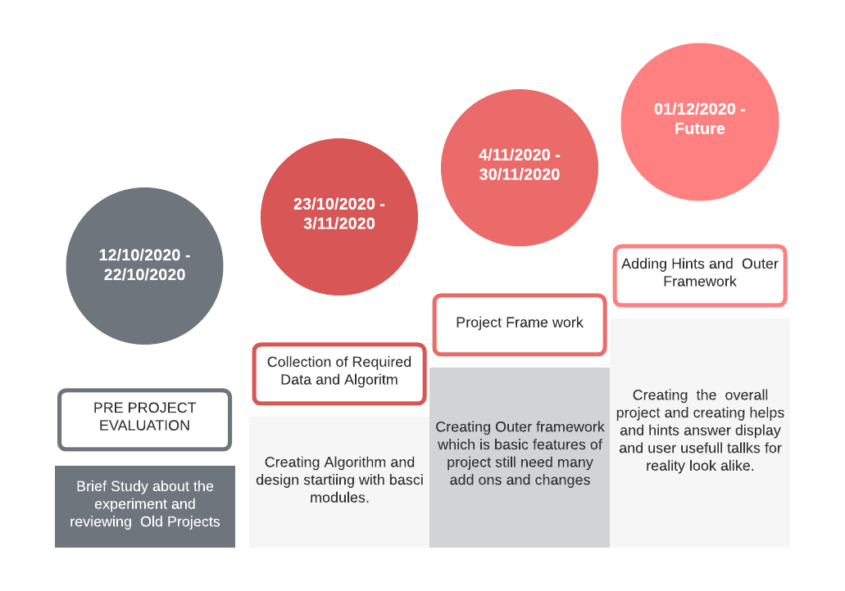
8 :) Project Plan

Slide 11
8A :) Gantt Chart

Slide 12
09 :) Methodology
START
Taking Input for Name and Displaying Basic Game Info.
Displaying Hints/Help
Yes
Asking for Use of Hints
If hints Left?
Displaying Questions with Its Option.
Yes
No
Right
If Answer ==
No
Displaying Money And Exit
WRONG
If All questions Answered Right
End Program

Slide 13
10 :) Expected Outcome
The Expected outcome will have a game in python shell which will take input of answer, helps and name of user.
Will display Scorecard, helps left, winning amount, hints and other user friendly talks to make it look like real life game.
The advantage of this kind of software is they are user friendly and works over offline based system.

Slide 14

11 :) Conclusion
It is a simple basic program made using basic Python functions and syntaxes.
Such basic programs also helps other new learners that creating common games using Python is much more simpler than other programming languages.

Slide 15
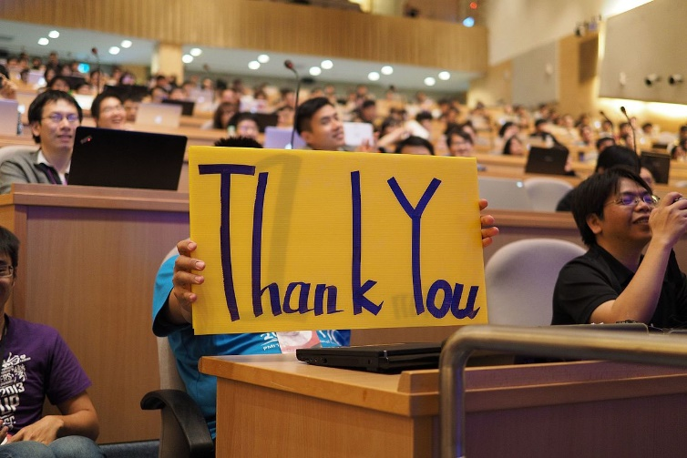

ANY QUERIES ?

